Slide 1
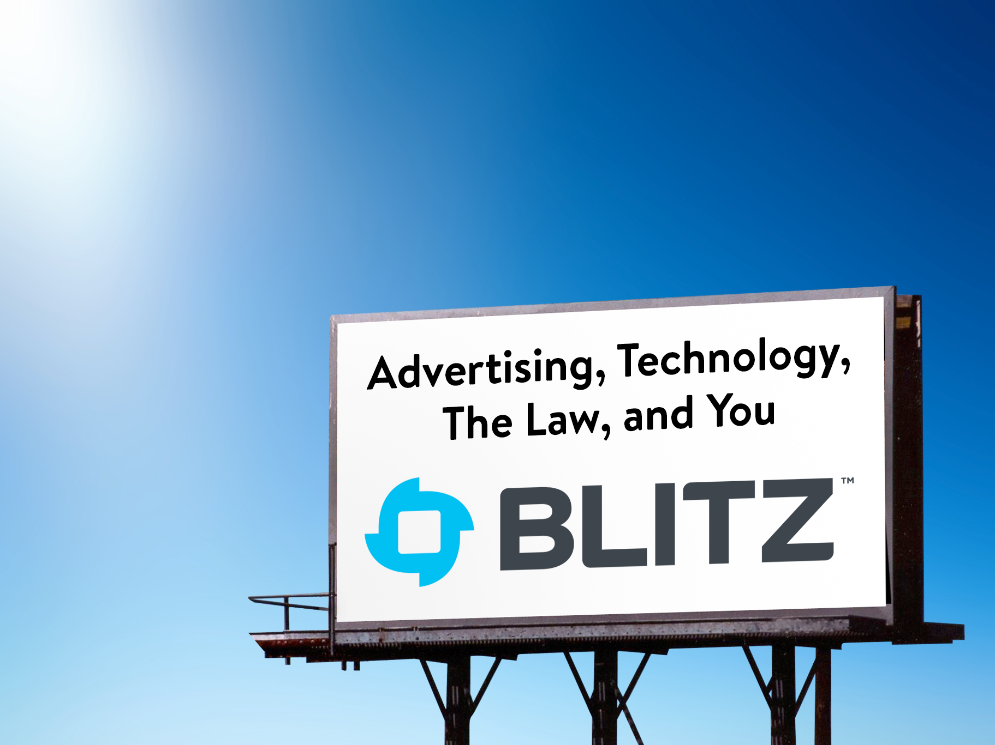
Advertising, Technology, The Law And You
Part 1

Slide 2
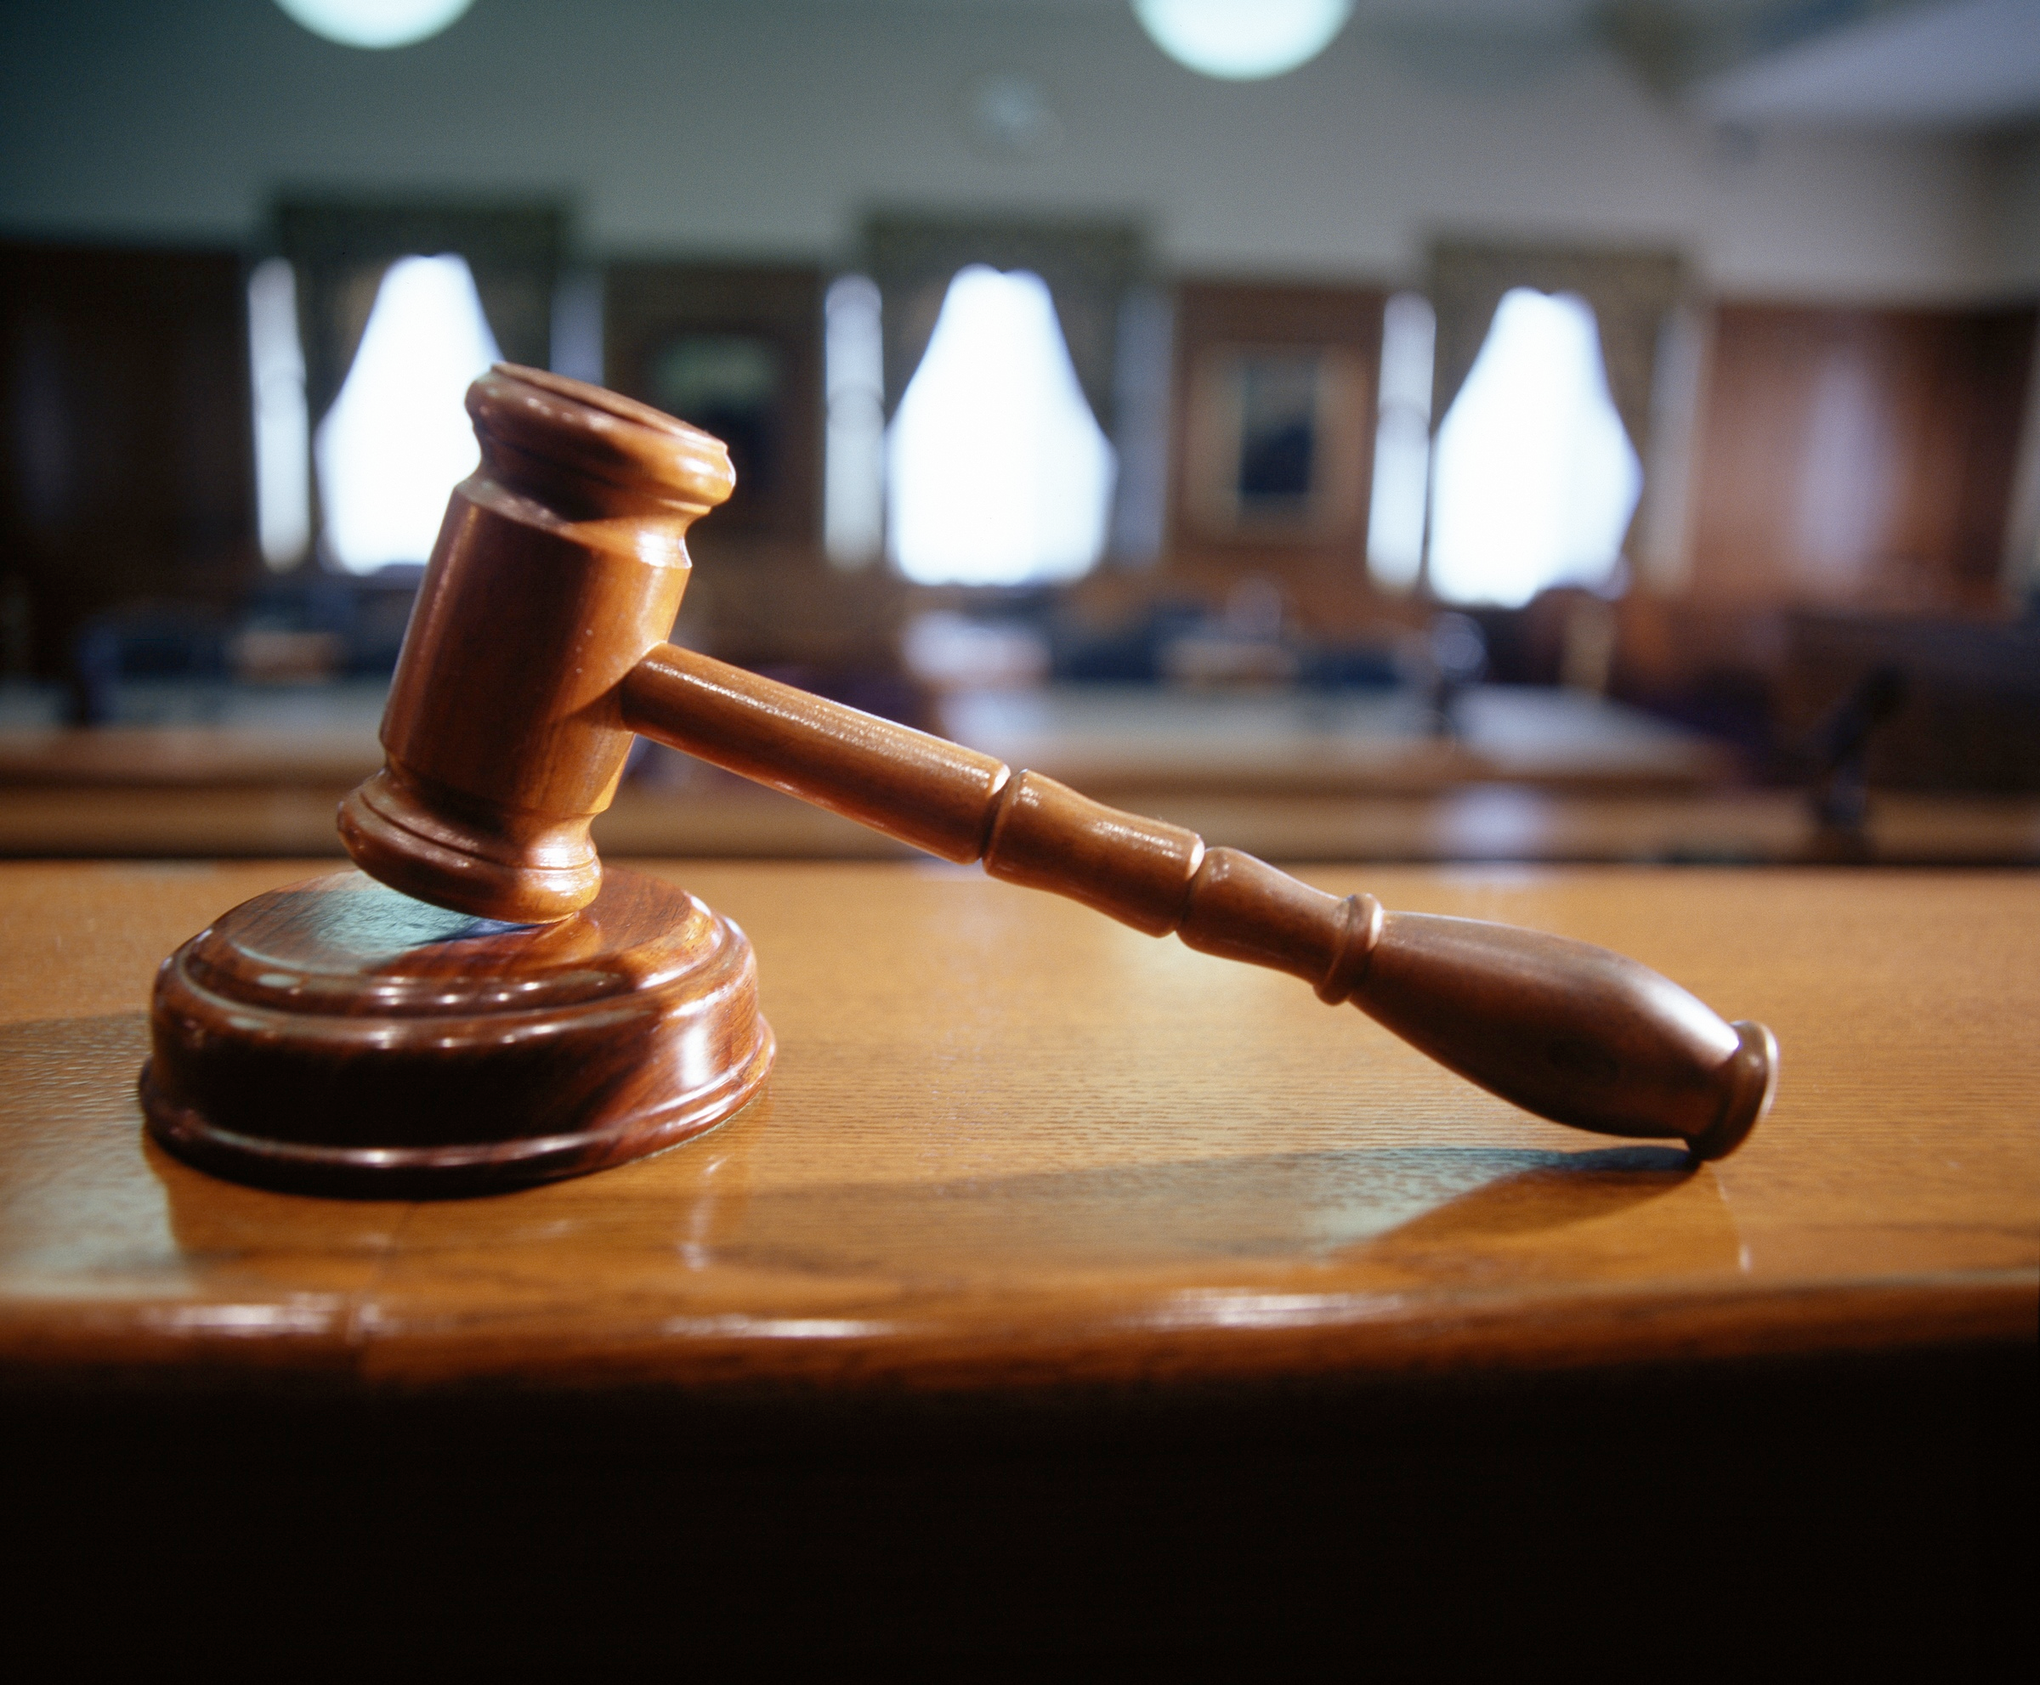
WHY ARE WE HERE?

Slide 3

to work together to minimize the agency’s risk
• Proactively set Protections
• Recognize the warning signs
• Alert the right people

Slide 4
RECOGNIZE
ALERT
PROTECT

Slide 5
CONTENTS:
CONTENT
PRIVACY
PATENTS

Slide 6

CONTENT

Slide 7
THREE PRIMARY AREAS OF CONCERN:
Copyrights: Fonts, Photos/Film, Music, Code, and Other Assets
Claims: What you Can and Can’t Say
Contests: Sweepstakes, Contests and Illegal Lotteries

Slide 8

Copyrights
Photos/Film/Music
Unless we shot it ourselves (as work for hire) or it was provided by the client it is covered by someone else’s copyright
Original shoots require releases (talent, location, etc)
For existing materials, there are many categories of rights that need to be purchased depending on usage. It doesn’t have to be published to violate usage rights.
Beware of implied endorsement (Logos, Celebs, Trademarks)
Stock Photos (Getty images, iStock, etc) have multiple types of licensing, restricting a number of different areas, (e.g. when, where and for how long it can be used)
Don’t assume that a photo can or will be licensed
Even for Stock Photos, Check the type of license

Slide 9
Copyrights
Fonts
Fonts Are Copyrightable and Copyrighted
“Free” Fonts, unless they are web safe browser fonts, are probably not free
Using a Font in a static asset is legal as long as we have a standard/desktop licenses for it
Using a Font dynamically requires a “web” license
Option 1 - Self Hosted License: Usually per font-face and font-weight. Usually Expensive
Option 2 - Font-Service: Usually licensed by total page views/month. Make sure clients are paying this bill.
Mistakes are Costly

Slide 10
Copyrights
Software
Regardless of patent protection, software is covered under copyright and other IP restrictions
Some of our clients require specific notification regarding the use of “third-party” software and libraries.
Obvious in the case of commercial software
Much more nuanced in the world of Free and Open-Source Software
Third Party companies available to validate and indemnify the use of FOSS.
Raise these questions with your TD/TL as well as your client.

Slide 11
This is complicated, What Can I Do?
RECOGNIZE:
• Read up on Copyright Protection
ALERT: Justin, Noah or Wilson (add to this the WHY)
PROTECT:
Seek counsel, provide counsel: Discuss with your project management lead, Justin and/or your client.
Discuss Software copyright with your Tech Director
Ensure that BLITZ has received proof of rights ownership prior to publishing
Licenses should be in the Client’s name, not BLITZ’s

Slide 12
CLAIMS

Slide 13
An Advertising Claim is any state made directly or implied about a characteristic, feature or capability of a product.

Slide 14
When a Claim is Okay
When it can be legally substantiated. The burden of proof is on the claimant (client).

Slide 15
When a Claim is Not Okay
When it is Unfair or Deceptive
This is covered under US Federal law
Separate Special category for
food, drugs, devices, services or
cosmetics
Be particularly mindful of competitive claims, as most suits are instigated by disgruntled competitors

Slide 16
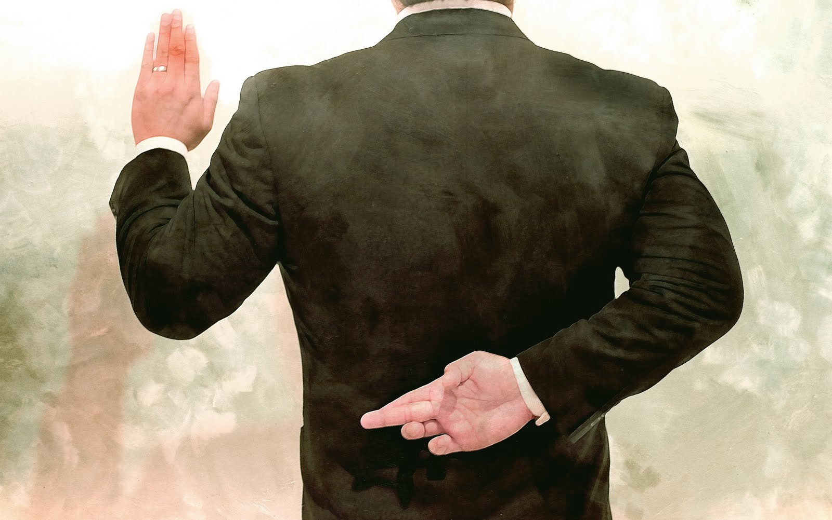
Deception
An advertisement is deceptive if it contains a misrepresentation or omission that is likely to mislead consumers acting reasonably under the circumstances to their detriment. Although deceptive claims are actionable only if they are material to consumers’ decisions to buy or use the product, the Commission need not prove actual injury to consumers

Slide 17
Unfair
An advertisement or trade
practice is unfair if it causes or is likely to cause substantial consumer injury which
is not reasonably avoidable by consumers themselves and which is not outweighed
by countervailing benefits to consumers or competition.

Slide 18
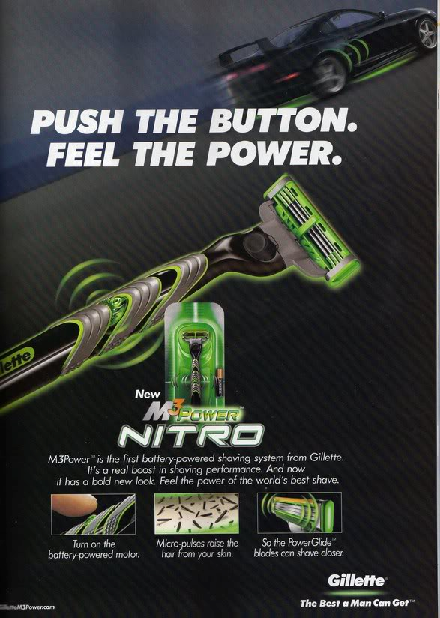
Problematic Claims

Slide 19
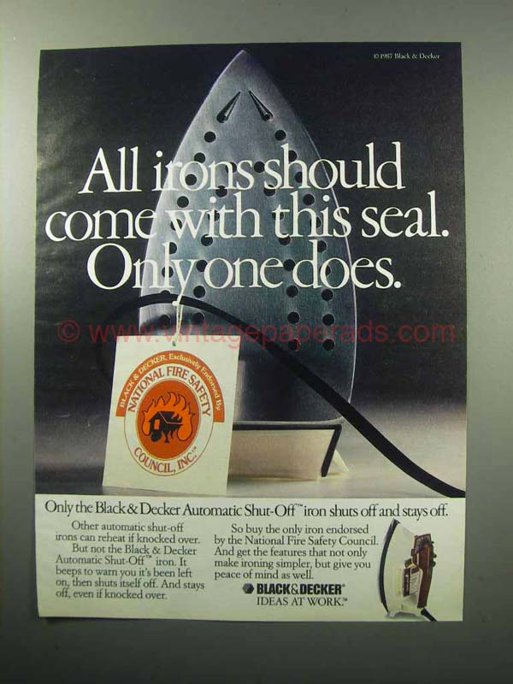
Problematic Claims

Slide 20
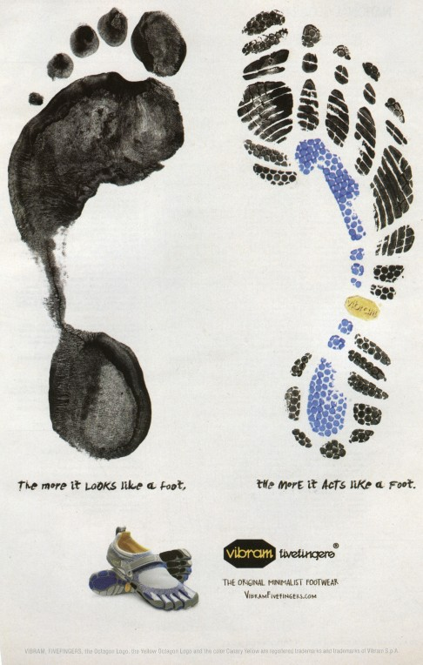
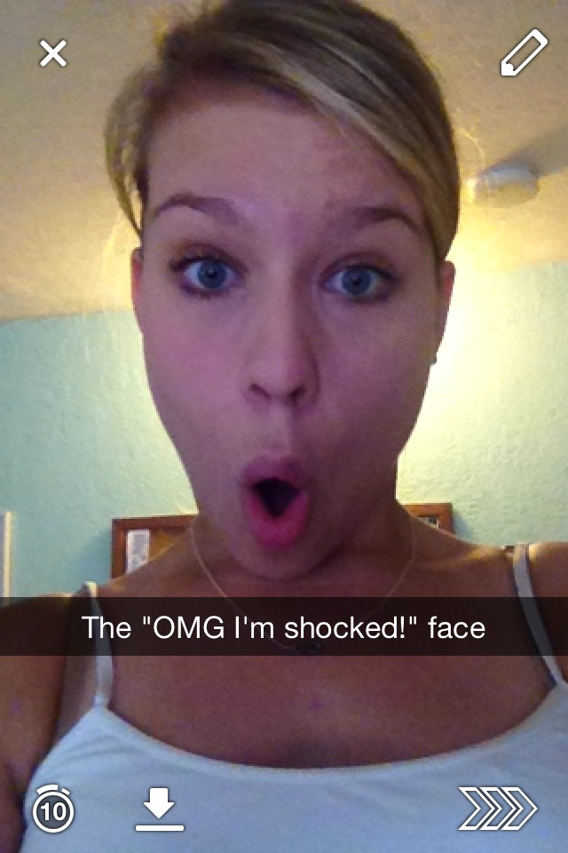
Problematic Claims

Slide 21
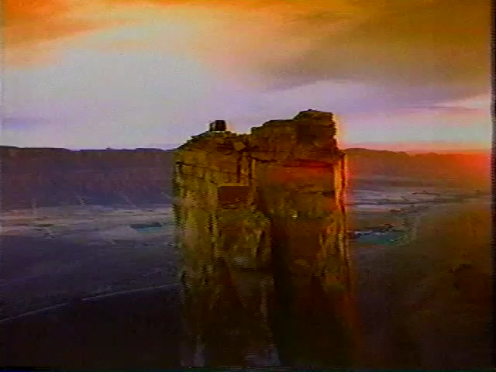
The Exception? Puffery

Slide 22
Consequences
Advertising agencies or website designers are responsible for reviewing the information used to substantiate ad claims. They may not simply rely on an advertiser's assurance that the claims are substantiated. In determining whether an ad agency should be held liable, the FTC looks at the extent of the agency's participation in the preparation of the challenged ad, and whether the agency knew or should have known that the ad included false or deceptive claims.
Notes:
FROM THE FTC

Slide 23
This is complicated, What Can I Do?
RECOGNIZE:
• http://www.ftc.gov/sites/default/files/attachments/training-materials/enforcement.pdf
ALERT: Client, and possibly Dean
PROTECT:
Ensure indemnification for BLITZ in MSAs, SOWs
Ensure that a client legal review of our work/copy is executed and documented
Leave time for Legal Review

Slide 24
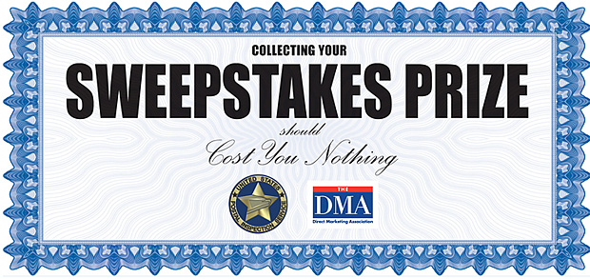
Sweepstakes, Contests and Promotions

Slide 25
This is illegal
Prize: This is pretty obvious
Chance: Is there an element of chance? How is the winner Selected?
Consideration: What are the barriers to entry?
Prize
Consideration
Chance
Prize+Chance = Sweepstakes
Prize+Consideration = Contest
Chance + Consideration = ???

Slide 26
What To Consider
BLITZ Always works with a 3rd Party Sweepstakes/Contest company for these things
BLITZ has a Sweepstakes Attorney for when we work in this area
Collection of PII is dangerous
You will need to have someone actually “Bond” your contest.
Just because you see other brands doing something doesn’t mean it’s legal or that you won't get caught.

Slide 27
This is complicated, What Can I Do?
RECOGNIZE:
• Read up more on Sweepstakes and Promotions
ALERT: Dean, Sweepstakes Attorney
PROTECT:
Ensure that all promotions are thoroughly vetted and have a schedule that accounts for legal review and bonding
Don’t get talked in to things you know are wrong

Slide 28
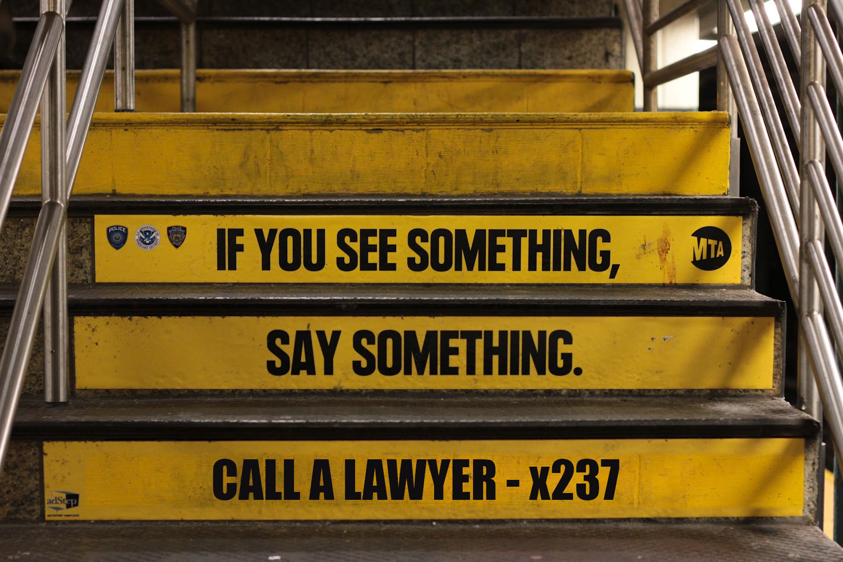
LEGAL REVIEW PROCESS

